Slide 1
CS 590 Algorithm
Chapter 7 Union-Find and Its Applications
Source: Goodrich, M. T., & Tamassia, R. (2015). Algorithm Design and Applications. Hoboken, NJ: Wiley.

Slide 2
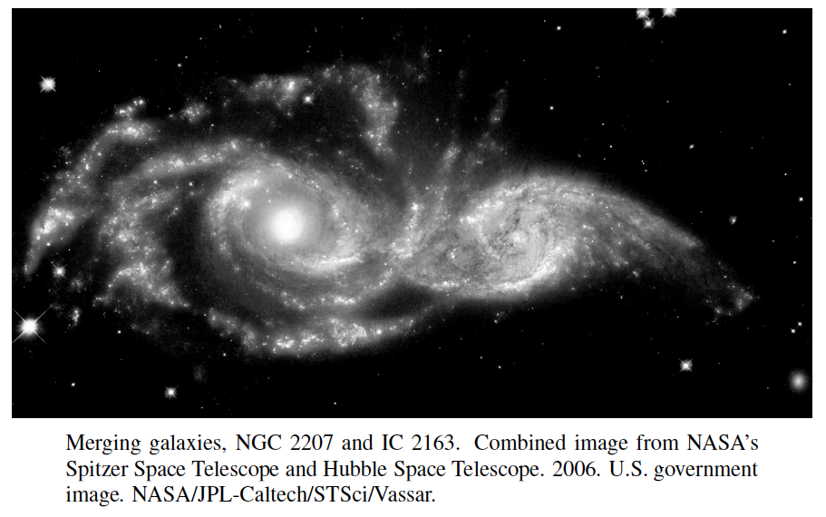
Union-Find Structures “Data Structure for Disjoint Sets”
Presentation for use with the textbook, Algorithm Design and Applications, by M. T. Goodrich and R. Tamassia, Wiley, 2015

Slide 3
Application: Connected Components in a Social Network
Social networking research studies how relationships between various people can influence behavior.
Given a set, S, of n people, we can define a social network for S by creating a set, E, of edges or ties between pairs of people that have a certain kind of relationship. For example, in a friendship network, like Facebook, ties would be defined by pairs of friends.
A connected component in a friendship network is a subset, T, of people from S that satisfies the following:
Every person in T is related through friendship, that is, for any x and y in T, either x and y are friends or there is a chain of friendship, such as through a friend of a friend of a friend, that connects x and y.
No one in T is friends with anyone outside of T.

Slide 4
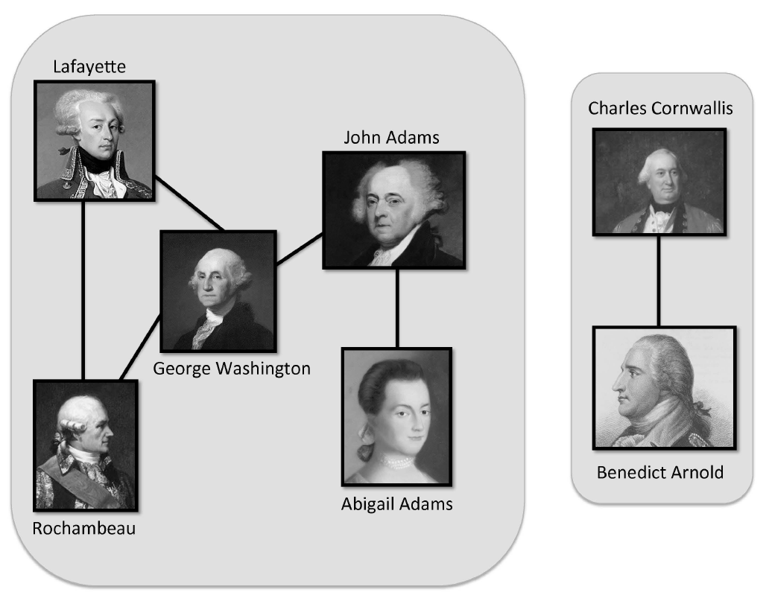
Example
2 Connected components in a friendship network of some of the key figures in the American Revolutionary War.
All images are in the public domain.

Slide 5
Union-Find Operations
A partition or union-find structure is a data structure supporting a collection of disjoint sets subject to the following operations:
makeSet(e): Create a singleton set containing the element e and return the position storing e in this set
union(A,B): Return the set A U B, naming the result “A” or “B”
find(e): Return the set containing the element e

Slide 6
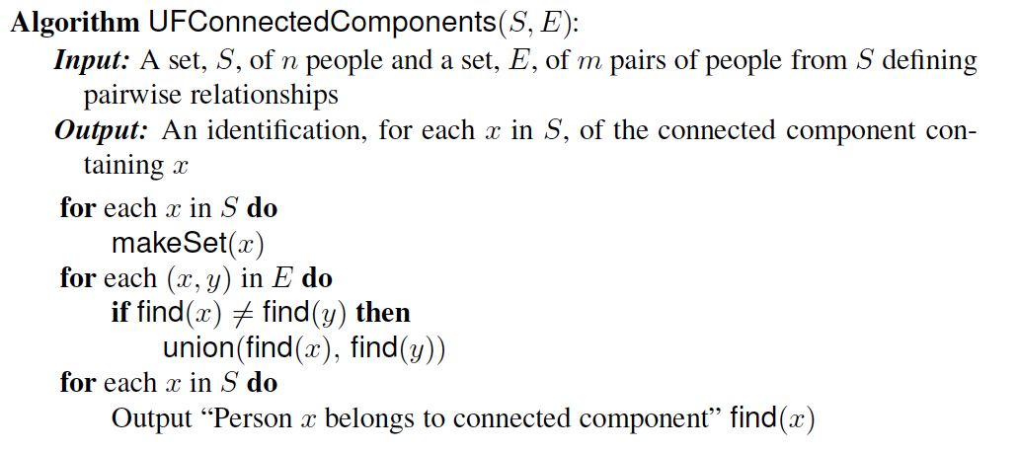
Connected Components Algorithm
The output from this algorithm is an identification, for each person x in S, of the connected component to which x belongs.
The running time of this algorithm is O(t(n,n+m)), where t(j,k) is the time for k union-find operations starting from j singleton sets.

Slide 7
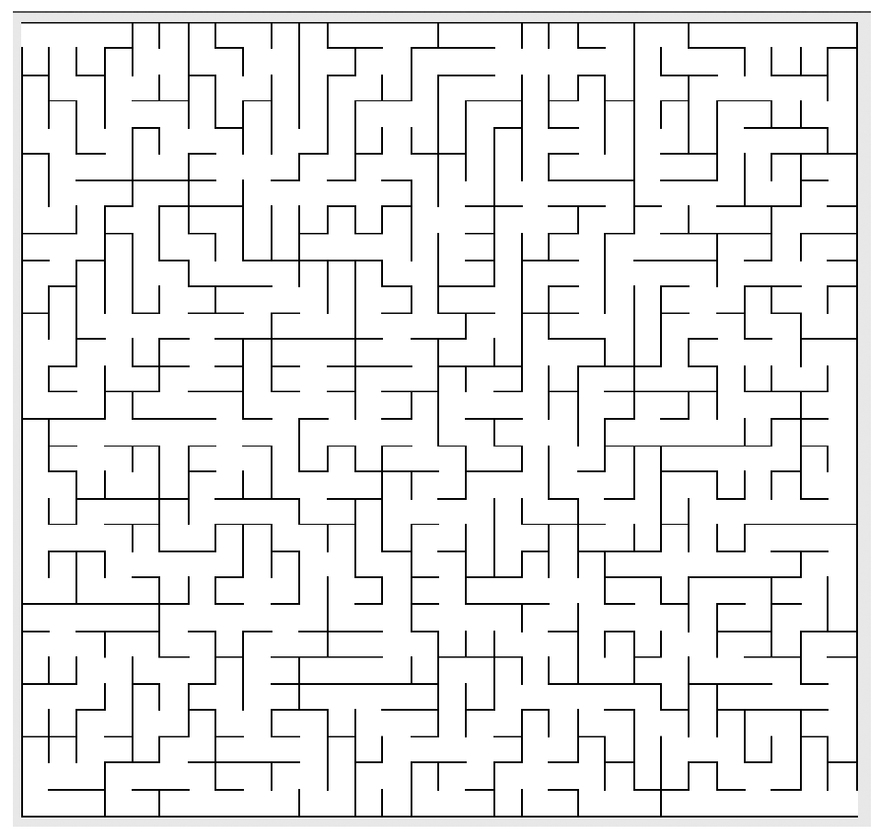
Another Application: Maze Construction and Percolation
Problem: Construct a good maze from a 30 by 30 square grid.
How many walls need to be removed?

Slide 8
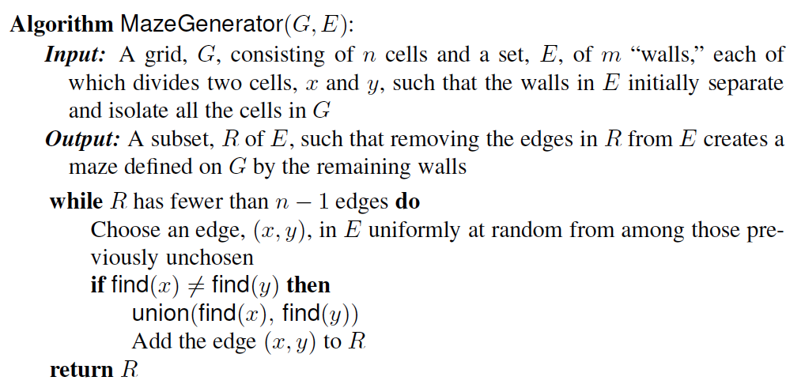
A Maze Generator
The running time of MazeGen is O(t(n+m)) for m union and n finds.
This is actually is related to the science of percolation theory, which is the study of how liquids permeate porous materials.
For instance, a porous material might be modeled as a three-dimensional n x n x n grid of cells. The barriers separating adjacent pairs of cells might then be removed virtually with some probability p and remain with probability 1 − p. Simulating such a system is another application of union-find structures.

Slide 9
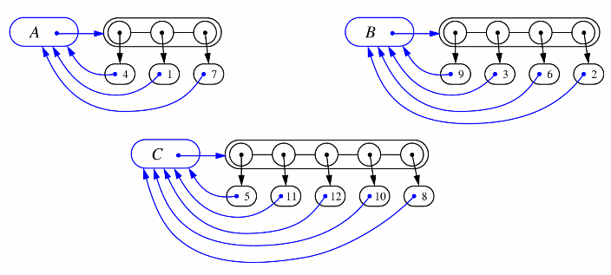
List-based Implementation
Each set is stored in a sequence represented with a linked-list
Each node should store an object containing the element and a reference to the set name

Slide 10
Analysis of List-based Representation
When doing a union, always move elements from the smaller set to the larger set
Each time an element is moved it goes to a set of size at least double its old set
Thus, an element can be moved at most O(log n) times.
How do we find the size of the sets?
See makeSet(), find(x), and Union(u,v) on Page 226
Theorems 7.1 and 7.2 establishes the Amortized running time of each Union operation takes O(logn) and each makSset and find takes O(1), hence
Total time needed to do m unions and n finds is O(nlog n + m).

Slide 11
Tree-based Implementation
Each element is stored in a node, which contains a pointer to a set name
A node v whose set pointer points back to v is also a set name
Each set is a tree, rooted at a node with a self-referencing set pointer
For example: The sets “1”, “2”, and “5”:
1
2
5
4
7
3
6
8
10
9
11
12

Slide 12
Union-Find Operations
5
makeSet assigns a parent pointer to each singleton element x and set x.size=1
To do a union, simply make the root of one tree point to the root of the other and set size as the sum of sizes.
To do a find, follow set-name pointers from the starting node until reaching a node whose set-name pointer refers back to itself
2
8
10
3
6
11
9
12
5
2
8
10
3
6
11
9
12

Slide 13
Union-Find Heuristic 1
Union by size:
When performing a union, make the root of smaller tree point to the root of the larger
Implies O(n log n) time for performing n find operations:
Each time we follow a pointer, we are going to a subtree of size at least double the size of the previous subtree
Thus, we will follow at most O(log n) pointers for any find.
5
2
8
10
3
6
11
9
12

Slide 14
Union-Find Heuristic 2
Path compression:
After performing a find, compress all the pointers on the path just traversed so that they all point to the root
Implies a fast “almost linear” time for n union-find operations.
5
5
8
10
8
10
11
11
2
12
2
12
3
6
3
6
9
9

Slide 15
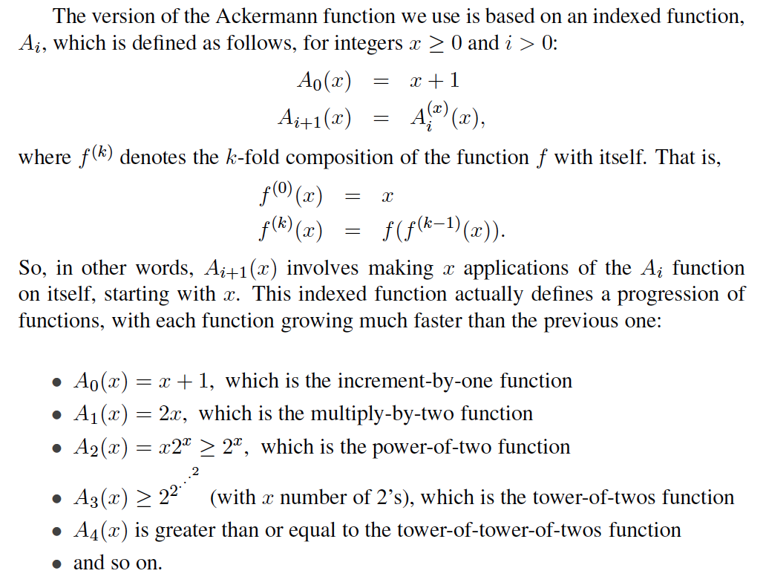
Ackermann Function

Slide 16
Ackermann Function
We then define the Ackermann function as
A(x) = A_{x}(2),
which is an incredibly fast-growing function.
To get some perspective, note that A(3) = 2048 and A(4) is greater than or equal to a tower of 2048 twos, which is much larger than the number of subatomic particles in the universe.
Likewise, its inverse, which is pronounced “alpha of n”,
α(n) = min{x: A(x) ≥ n},
is an incredibly slow-growing function. Even though α(n) is indeed growing as n goes to infinity, for all practical purposes, α(n) ≤ 4.

Slide 17
Fast Amortized Time Analysis (1/7)
For each node v in the union tree that is a root
define n(v) to be the size of the subtree rooted at v (including v)
identified a set with the root of its associated tree.
We update the size field of v each time a set is unioned into v. Thus, if v is not a root, then n(v) is the largest the subtree rooted at v can be, which occurs just before we union v into some other node whose size is at least as large as v ’s.
For any node v, then, define the rank of v, which we denote as r(v), as r(v) = (Floor of log n(v)) + 2:
Thus, n(v) ≥ 2^{r(v)-2}.
Also, since there are at most n nodes in the tree of v, r(v) < [log n]+2, for each node v.

Slide 18
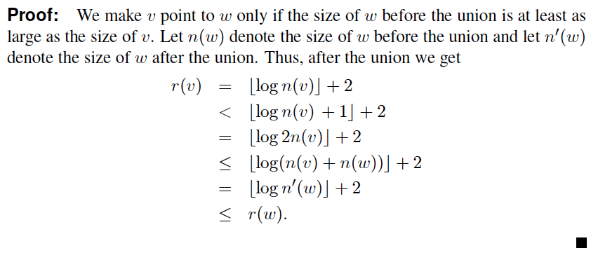
Amortized Time Analysis (2/7)
For each node v with parent w:
r (v ) < r (w )
Thus, ranks are strictly increasing as we follow parent pointers.

Slide 19
Amortized Time Analysis (3/7)
Lemma 7.5: There are at most n/ 2^{s-2} nodes of rank s.
Proof:
Since r(v) < r(w), for any node v with parent w, ranks are monotonically increasing as we follow parent pointers up any tree.
Thus, if r(v) = r(w) for two nodes v and w, then the nodes counted in n(v) must be separate and distinct from the nodes counted in n(w).
If a node v is of rank s, then n(v) ≥ 2^{s-2}.
Therefore, since there are at most n nodes total, there can be at most n/2^{s-2} that are of rank s.

Slide 20
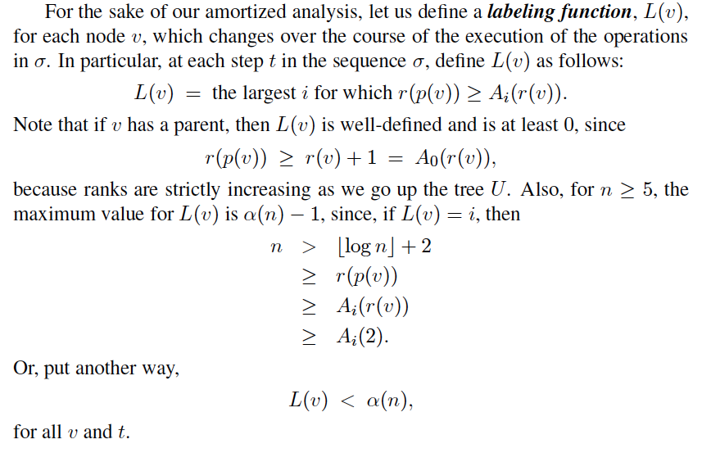
Amortized Time Analysis (4/7)

Slide 21
Amortized Time Analysis (5/7)
Let v be a node along a path, P, in the union tree. Charge 1 cyber-dollar for following the parent pointer for v during a find:
If v has an ancestor w in P such that L(v) = L(w), at this point in time, then we charge 1 cyber-dollar to v itself.
If v has no such ancestor, then we charge 1 cyber-dollar to this find.
Since there are most α(n) rank groups, this rule guarantees that any find operation is charged at most α(n) cyber-dollars.

Slide 22
Amortized Time Analysis (6/7)
After we charge a node v then v will get a new parent, which is a node higher up in v’s tree.
The rank of v’s new parent will be greater than the rank of v’s old parent w.
Any node v can be charged at most r(v) cyber-dollars before v goes to a higher label group.
Since L(v) can increase at most α(n)-1 times, this means that each vertex is charged at most r(n)α(n) cyber-dollars.

Slide 23

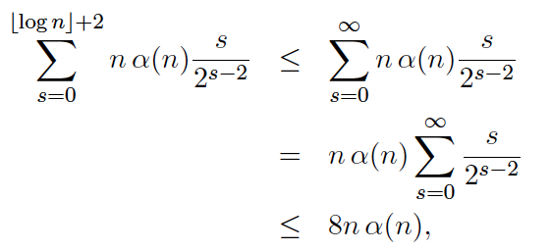
Amortized Time Analysis (7/7)
Combining this fact with the bound on the number of nodes of each rank, this means there are at most
cyber-dollars charged to all the vertices of rank s.
Suming over all possible ranks, the total number of cyber-dollars charged to all nodes is at most
using Theorem A.15. So the total time for m union-find operations, starting with n singleton sets is O((n+m)α(n)).

Slide 24
About Stevens
A premier, private research university with a mission to inspire, nurture and educate leaders in tomorrow’s technology-centric environment while contributing to the solution of the most challenging problems of our time

